Slide 1
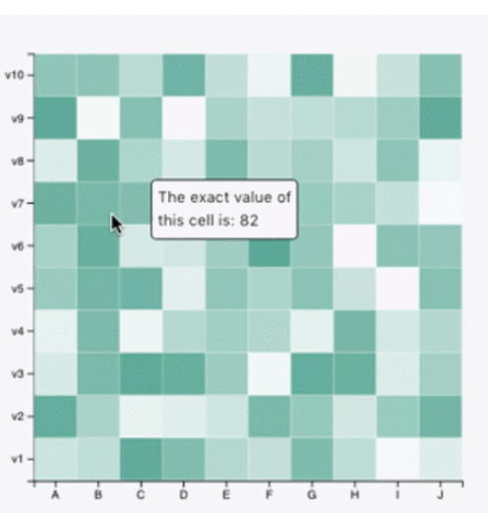
Aim: Share prototype charts and design processes
Final chart type: interactive heatmap in d3js with tooltips
The tool tip will show the male/female breakdown of workers in that category.
Data:
3 categorical fields
Education level
Salary band
Sex
Data pre-processing:
Dropped any where the participants chose not to reveal their salary or their education level.
Also dropped gender identities other than male and female as the gender pay gap is based on an individual’s legal sex (e.g. biological sex or legal sex as documented on their GRC). This is as close as we can get to the legal salary reporting on.
Data is aggregated into counts per category (education and salary)
User needs/interests:
Gender pay gap
Women earn less than men on average for doing the same work
Companies above a certain size have to publish their gender pay gap in the UK.
Having more transparency on salaries is likely to empower women to negotiate their salaries at appointment or at review.

Slide 2
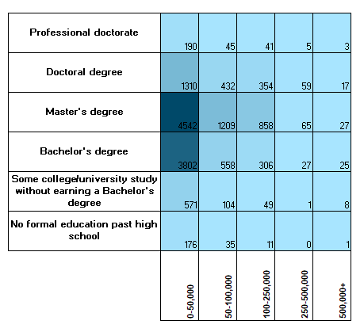
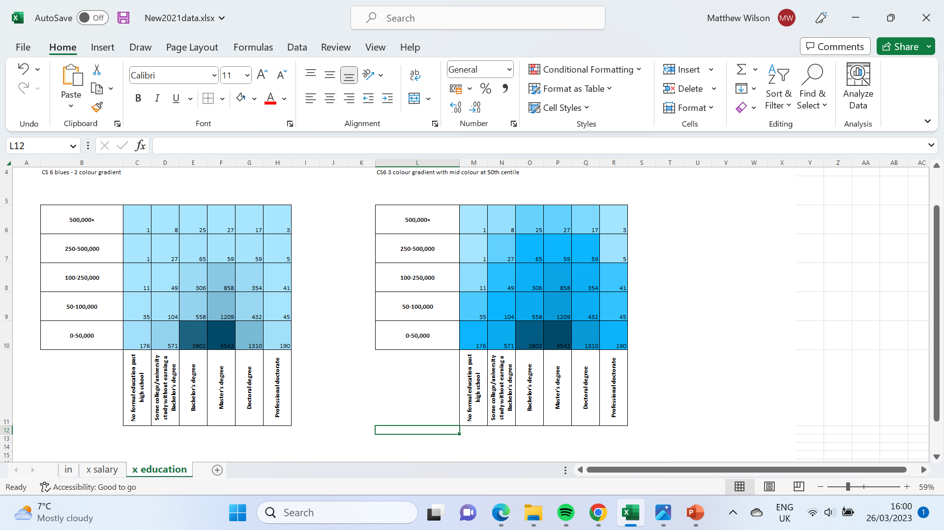
Aim: Share prototype charts and design processes
Progress:
Two iterations of the chat with the axis opposite ways round. Both are ordinal categories so I wanted to see which is more user friendly.
Option B was chosen because when I add in the interactivity on gender, the primary trend a user will be looking at is salary, not education and the trend displays more logically with salary on the y axis.
B
A

Slide 3
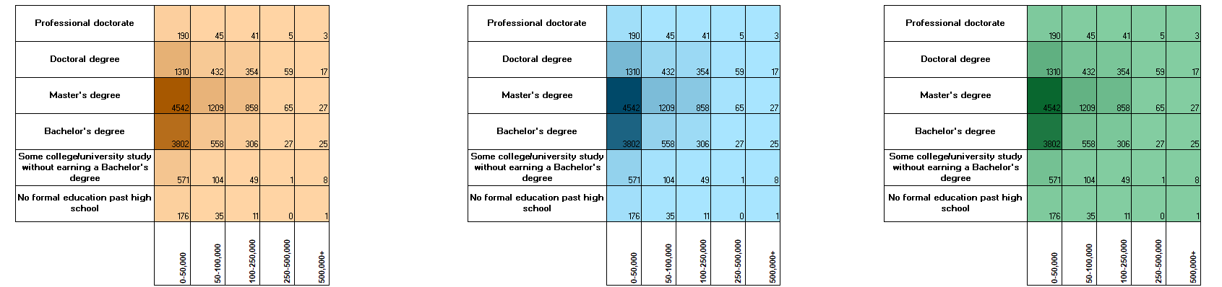

Aim: Share prototype charts and design processes
Colour scheme:
Using a provisional colour scheme, I tried different monochromatic schemes.
Blue was chosen as the preferred colour due to it being visually calming, the depths of colour display better, and it’s also the colour of Kaggle’s branding, which links to the professional application and branding considerations

Slide 4
Aim: Share prototype charts and design processes
Colour scheme:
The data I’m presenting is ordinal so a sequential colour scheme is required to appropriately visualise the data.
A monochromatic sequential scheme was used from within our provisionally discussed colour scheme.
Depth/intensity of colour increases as the count in each category increases.
I tried having a 2 shade gradient and a 3 shade gradient. 3 shades conveys meaning better than 2 at a glance, which is important for digital media and allowing users to pick up information when scrolling on social media in case a still version of the image was used
A contrasting colour from within the scheme might be used for the tool tip for clarity. This is likely to be an orange/red shade that is opposite on the colour wheel.

